Slide 1


Annual
AML Training
2016

Slide 2

Anti Money Laundering

Slide 3
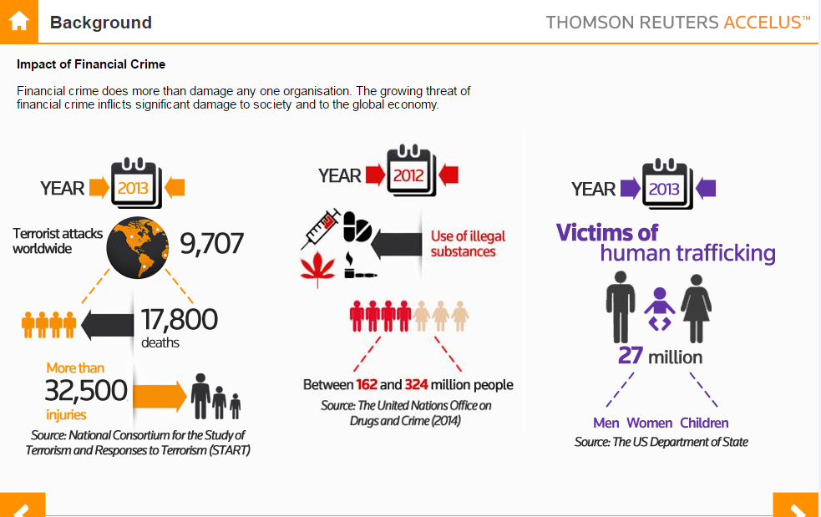
Anti Money Laundering

Slide 4
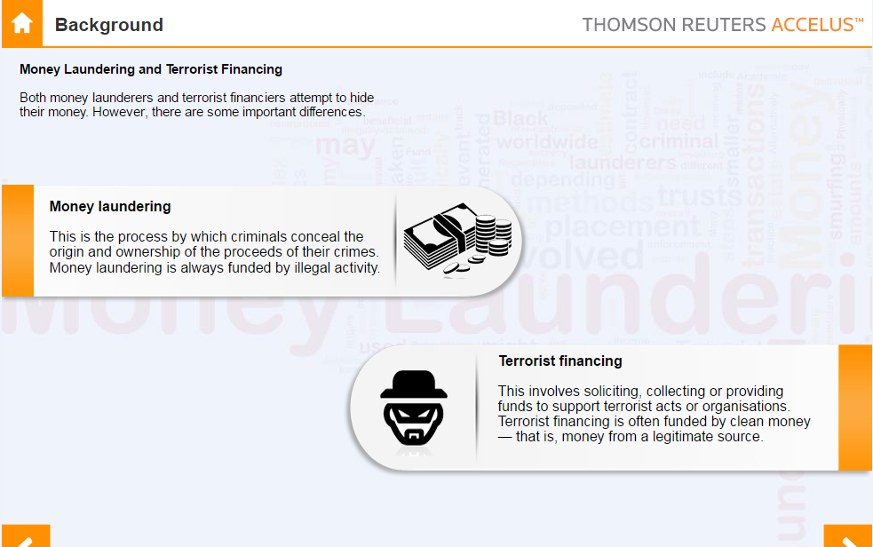
Anti Money Laundering

Slide 5
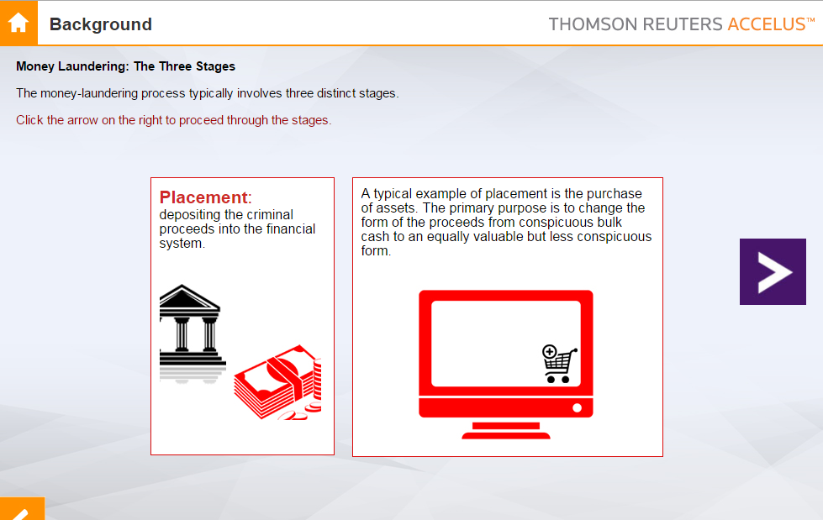
Anti Money Laundering

Slide 6
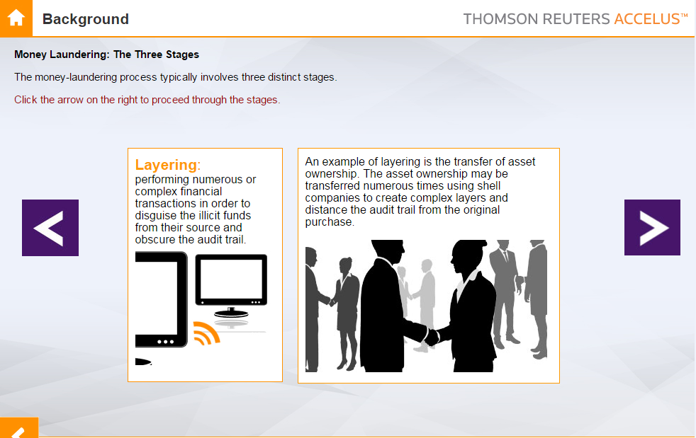
Anti Money Laundering

Slide 7
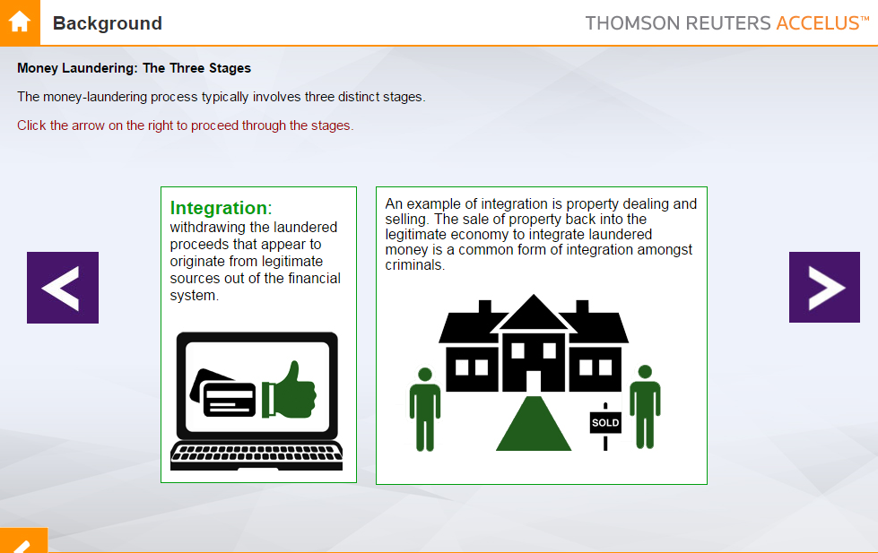
Anti Money Laundering

Slide 8
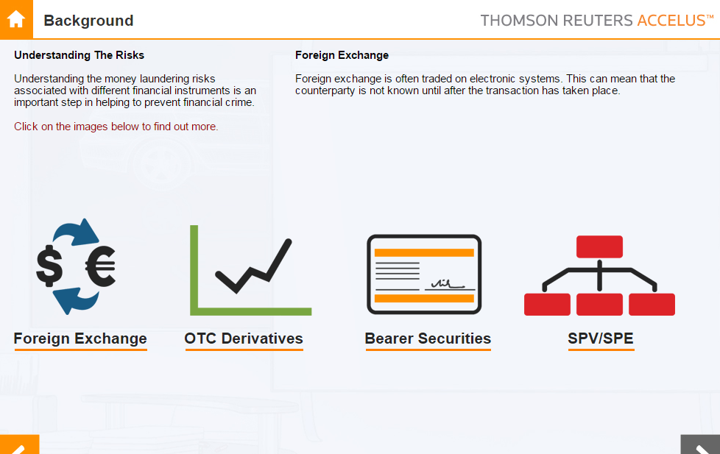
Anti Money Laundering

Slide 9
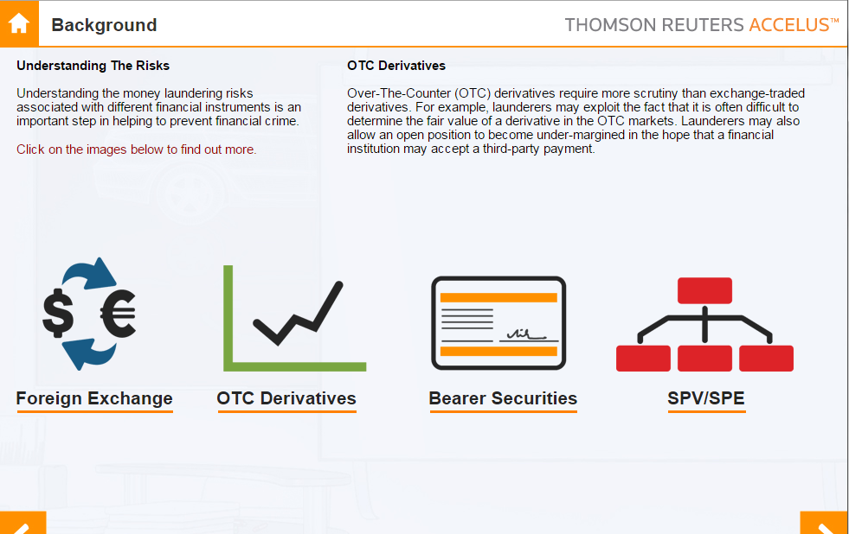
Anti Money Laundering

Slide 10
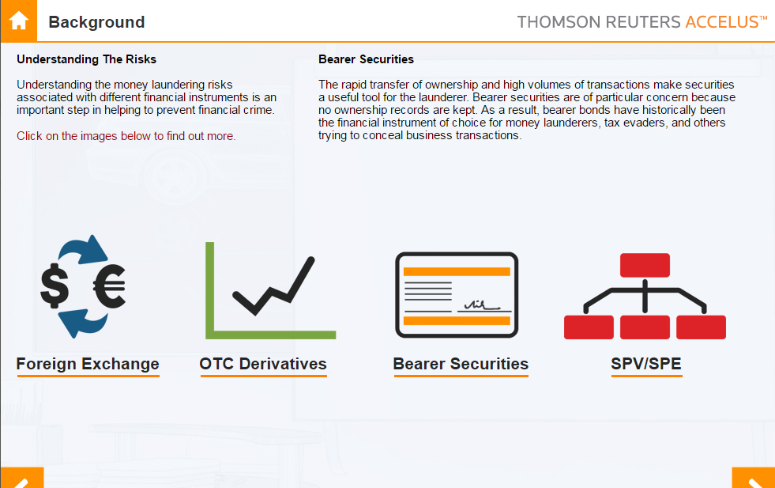
Anti Money Laundering

Slide 11
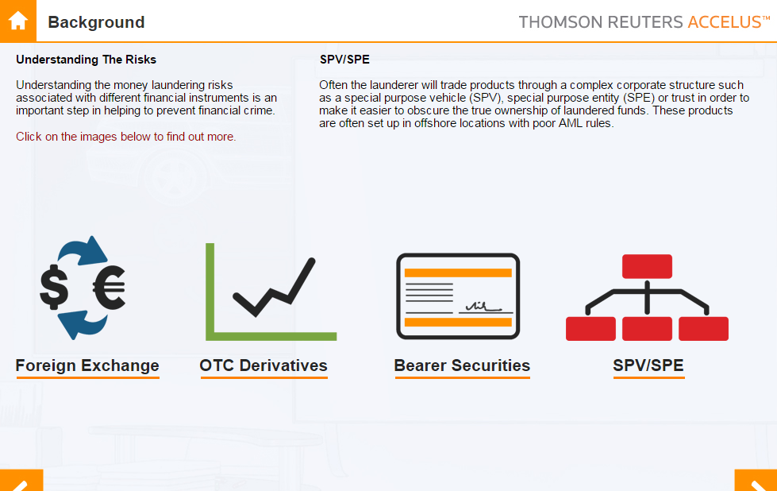
Anti Money Laundering

Slide 12
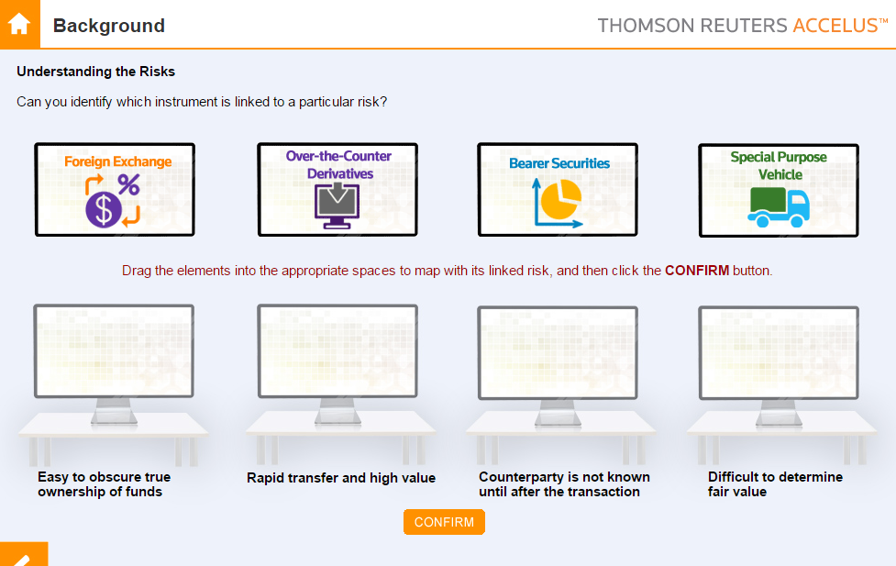
Anti Money Laundering
A
B
C
D

Slide 13

Anti Money Laundering

Slide 14
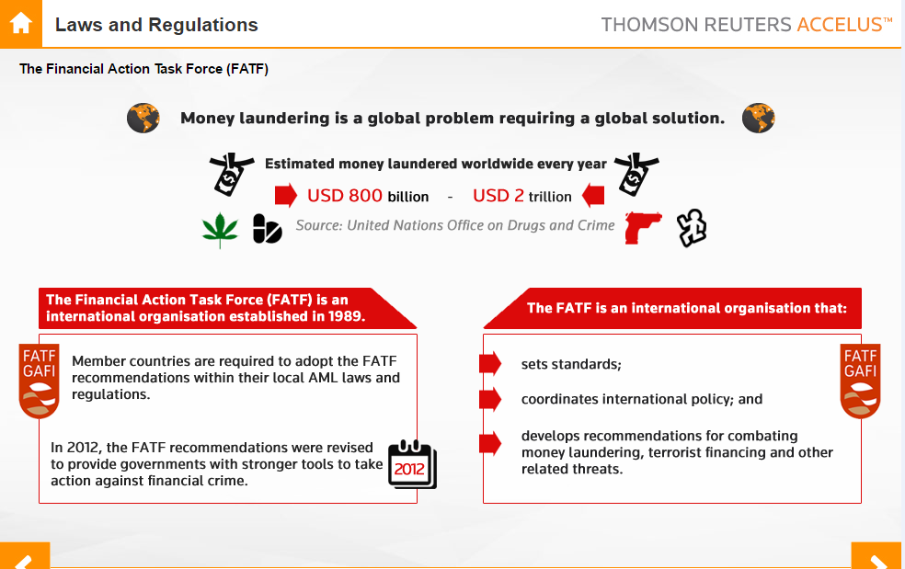
Anti Money Launderingc

Slide 15
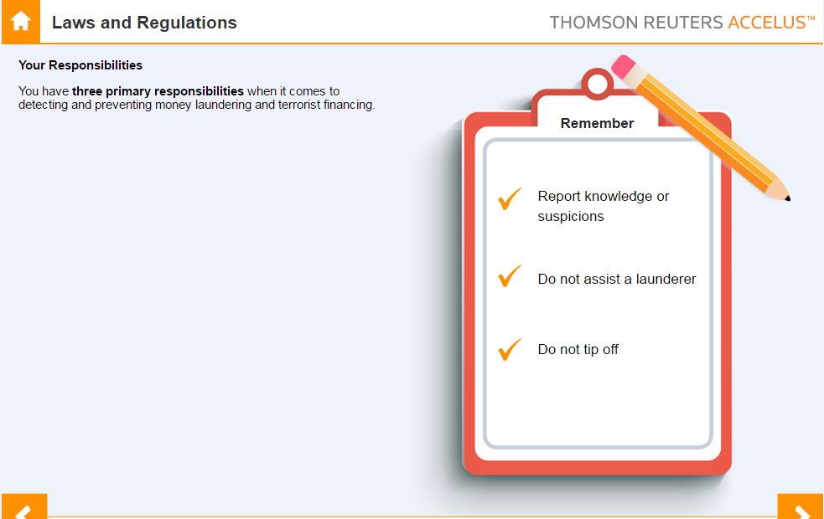
Anti Money Laundering

Slide 16
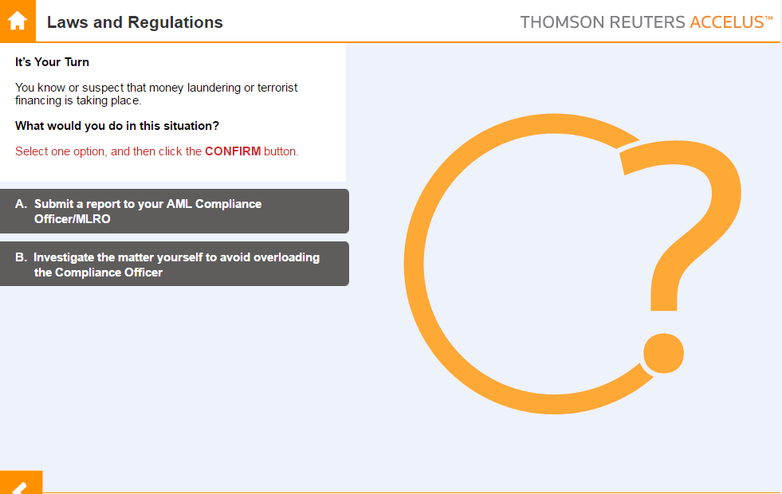
Anti Money Laundering

Slide 17
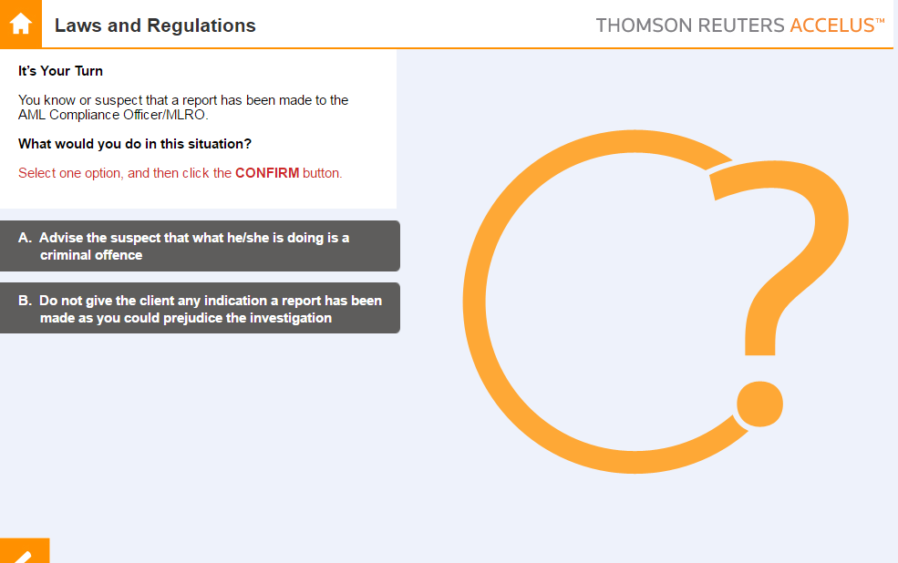
Anti Money Laundering

Slide 18
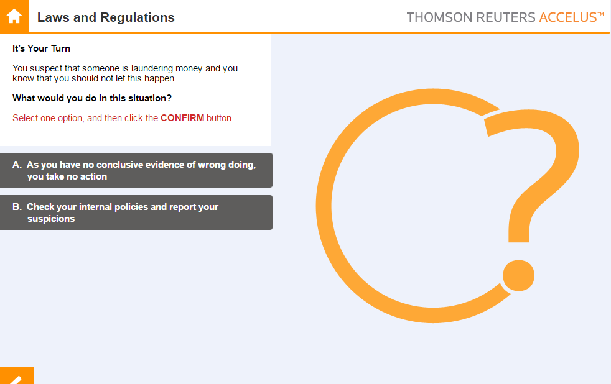
Anti Money Laundering

Slide 19
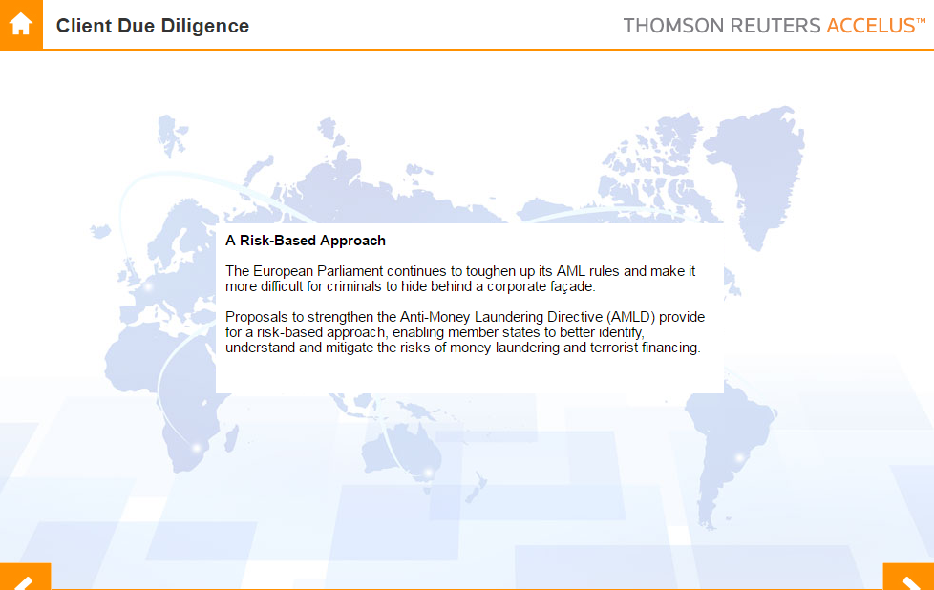
Anti Money Laundering

Slide 20
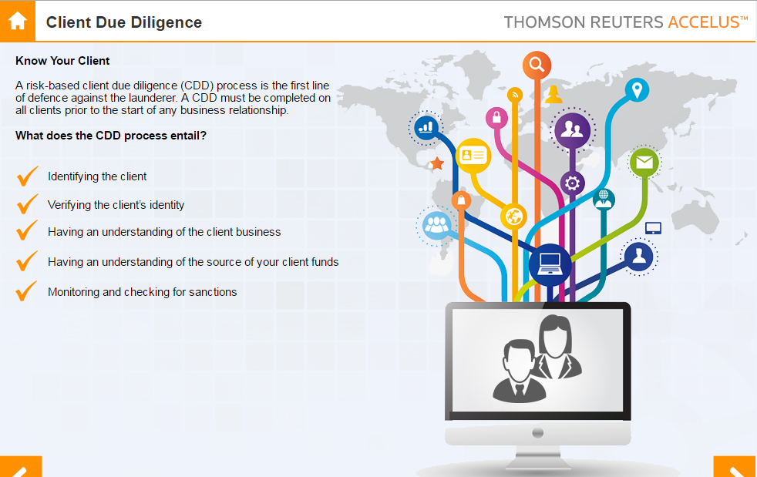
Anti Money Laundering

Slide 21
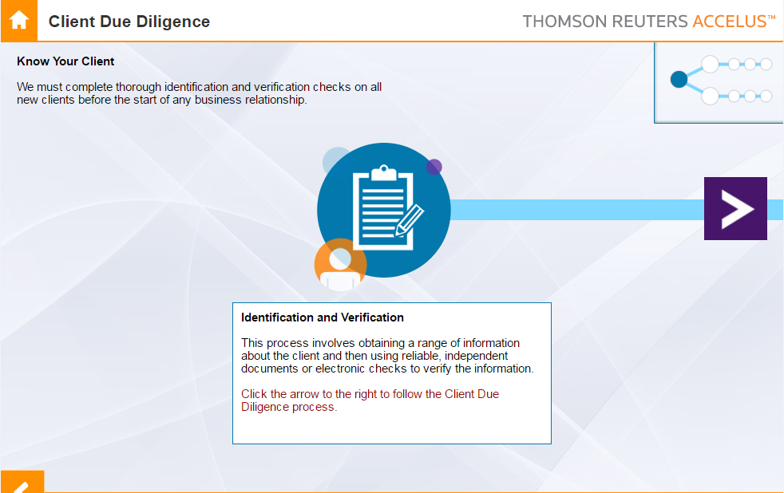
Anti Money Laundering

Slide 22
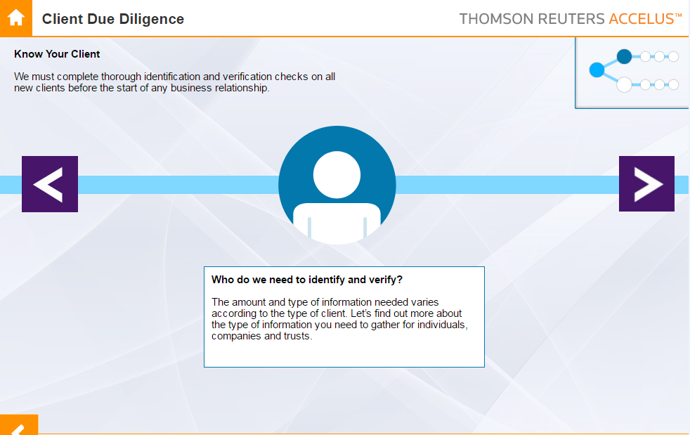
Anti Money Laundering

Slide 23
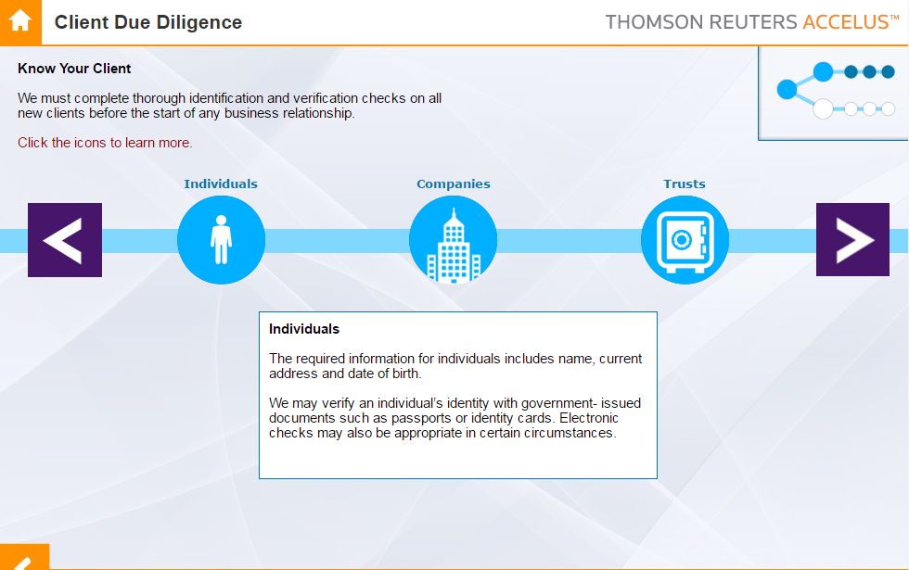
Anti Money Laundering

Slide 24
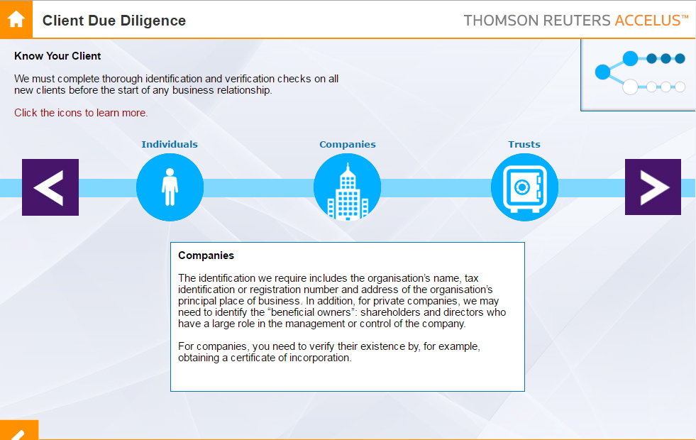
Anti Money Laundering

Slide 25
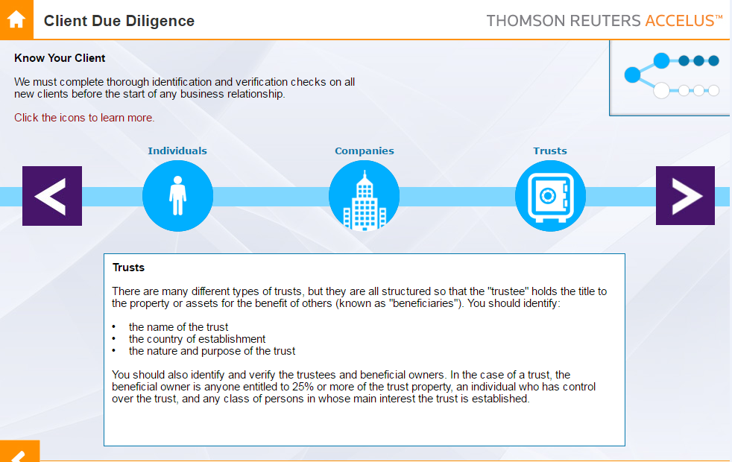
Anti Money Laundering

Slide 26
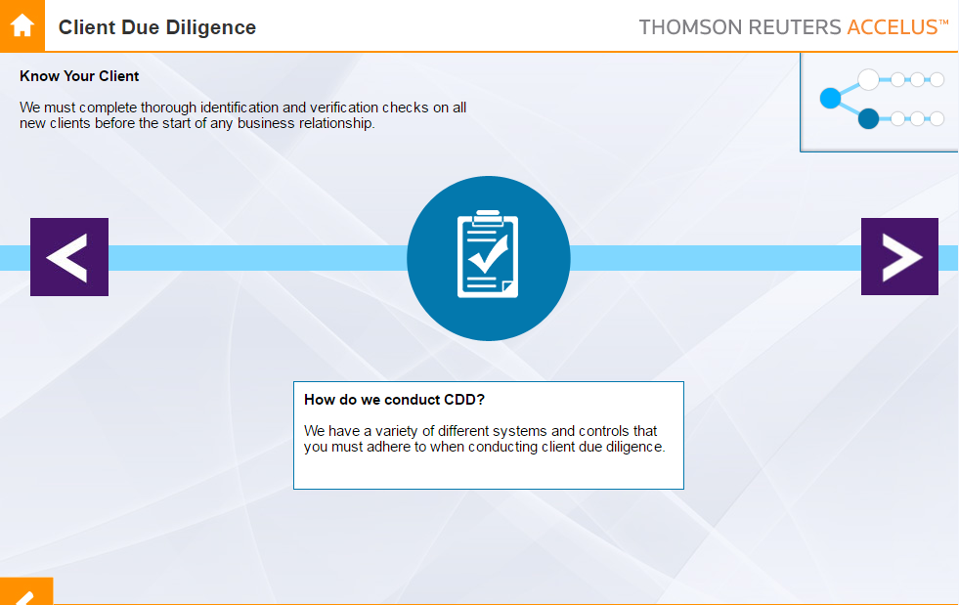
Anti Money Laundering

Slide 27
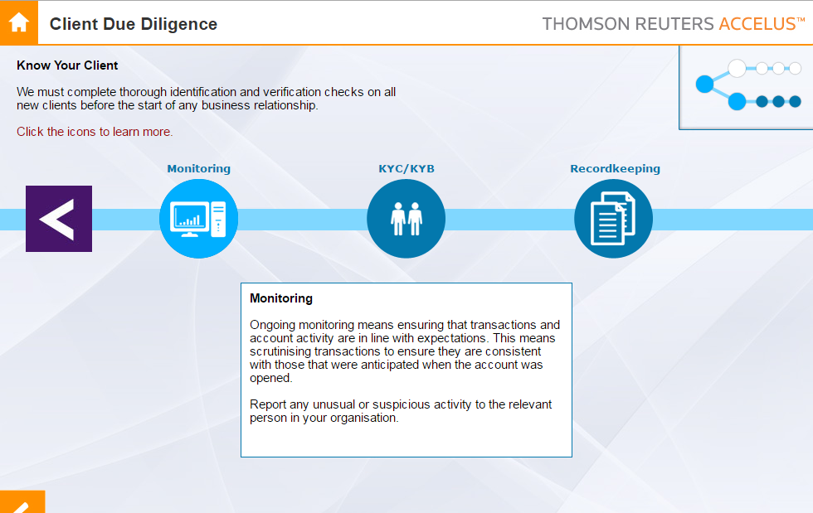
Anti Money Laundering

Slide 28
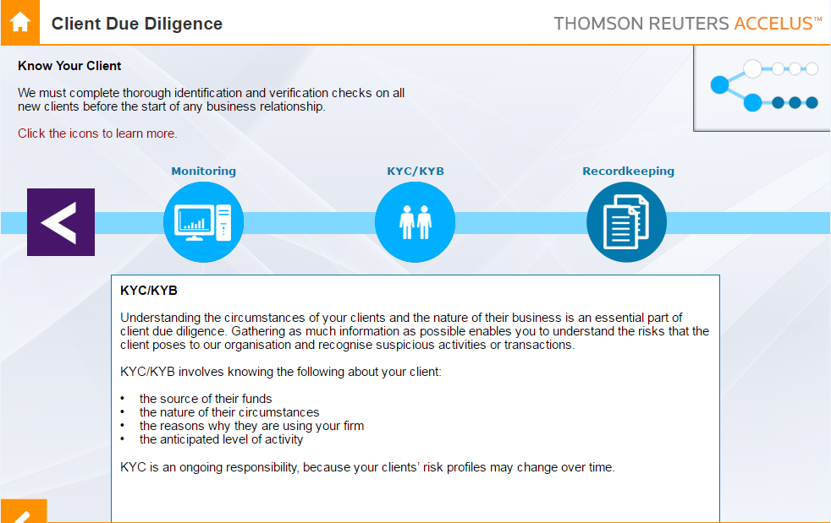
Anti Money Laundering

Slide 29
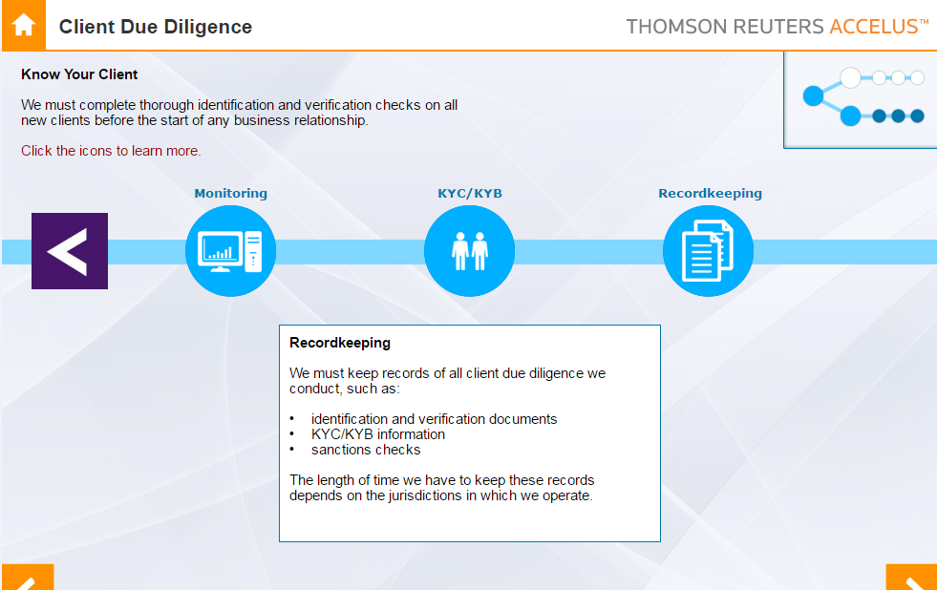
Anti Money Laundering

Slide 30
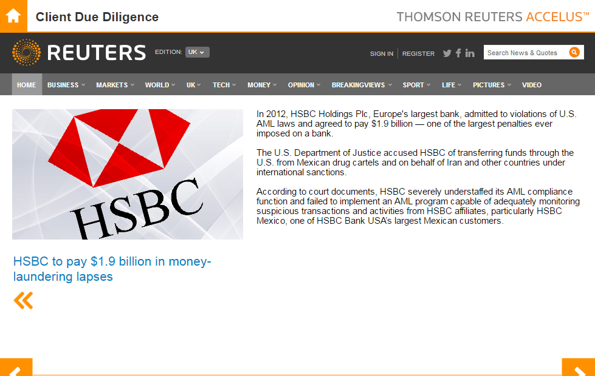
Anti Money Laundering

Slide 31
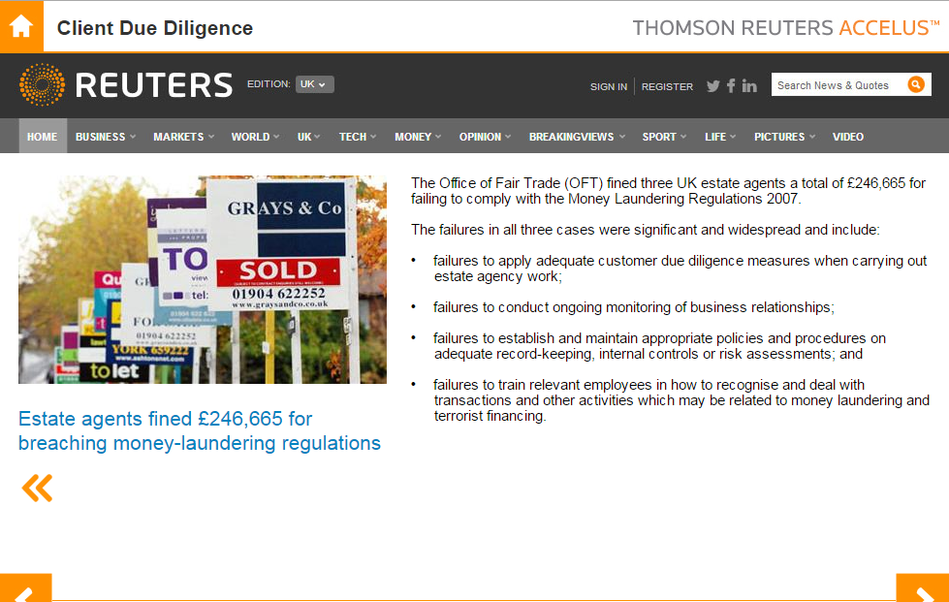
Anti Money Laundering

Slide 32
SFC Enforcement news: SFC reprimands and fines Guotai Junan Securities (Hong Kong) Limited $1.3 million The Securities and Futures Commission (SFC) has reprimanded and fined Guotai Junan Securities (Hong Kong) Limited (Guotai Junan) $1.3 million for non-compliance with the regulatory requirements in relation to ascertaining client identity
Anti Money Laundering

Slide 33
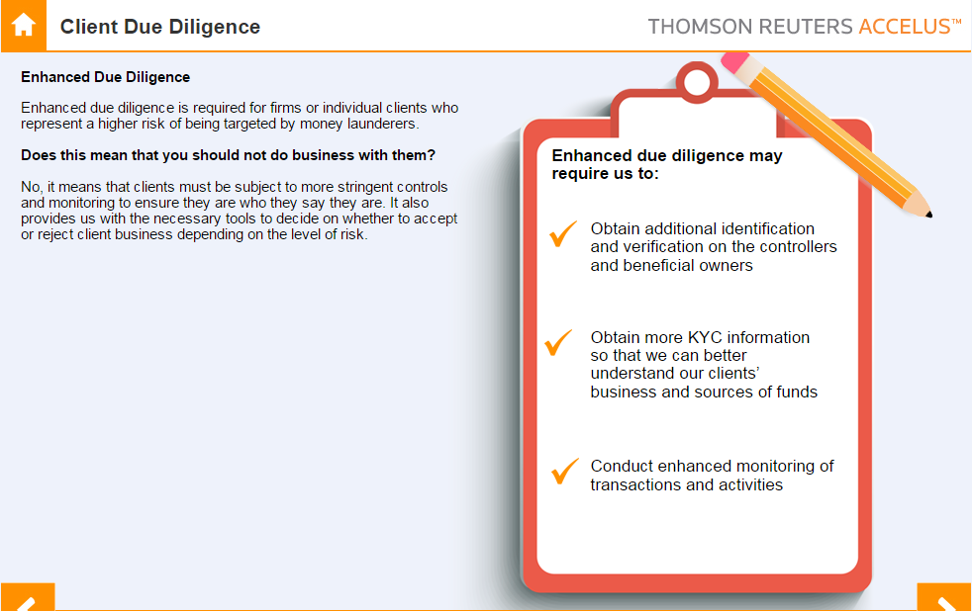
Anti Money Laundering

Slide 34
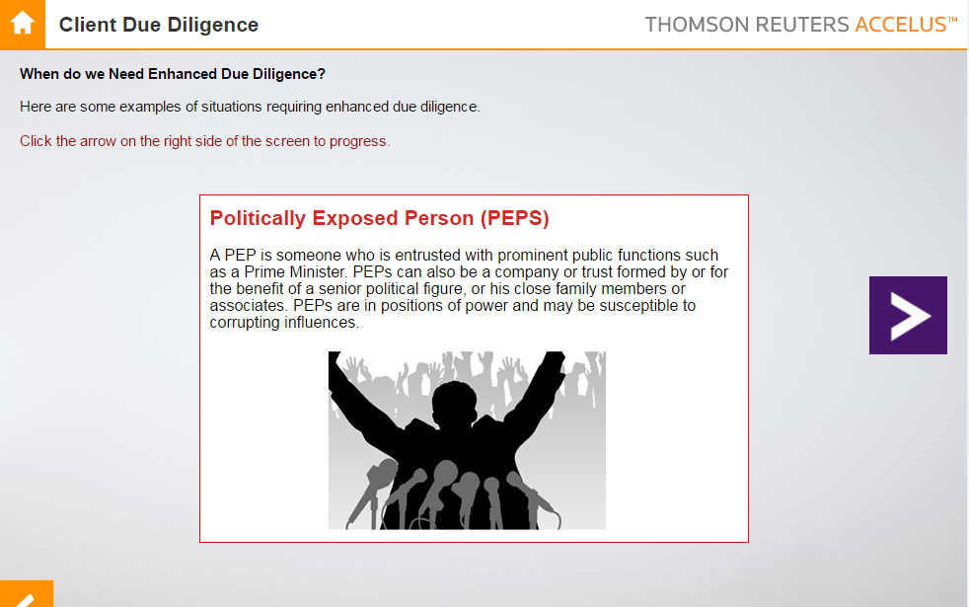
Anti Money Laundering

Slide 35
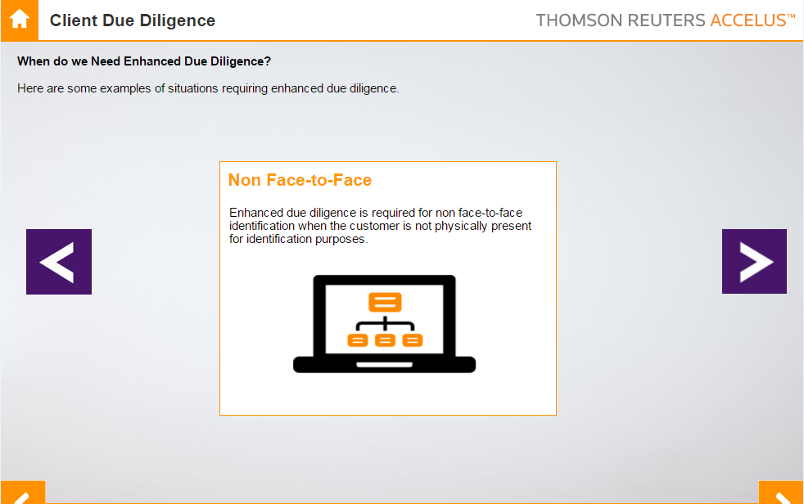
Anti Money Laundering

Slide 36
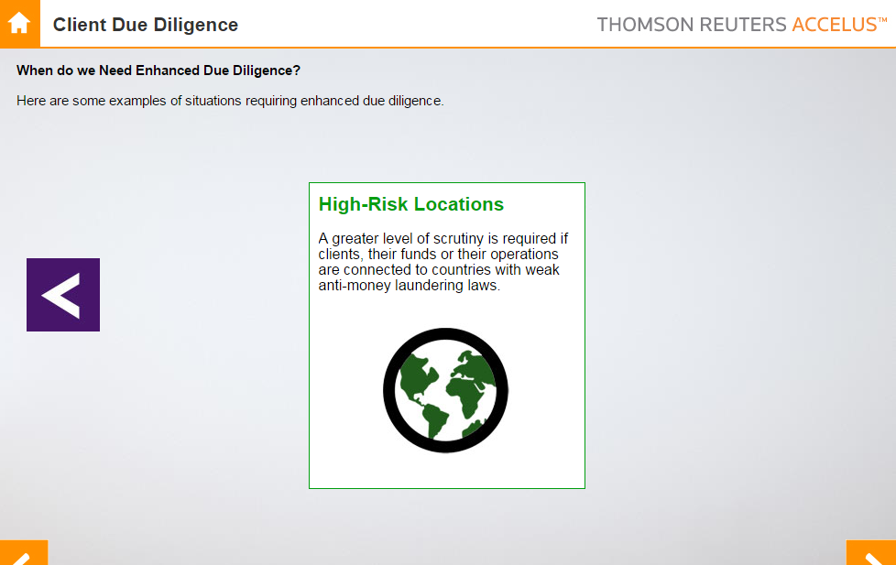
Anti Money Laundering

Slide 37
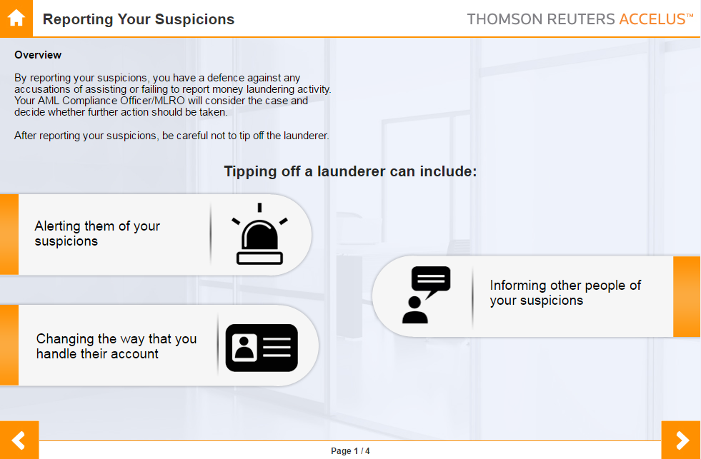
Anti Money Laundering

Slide 38
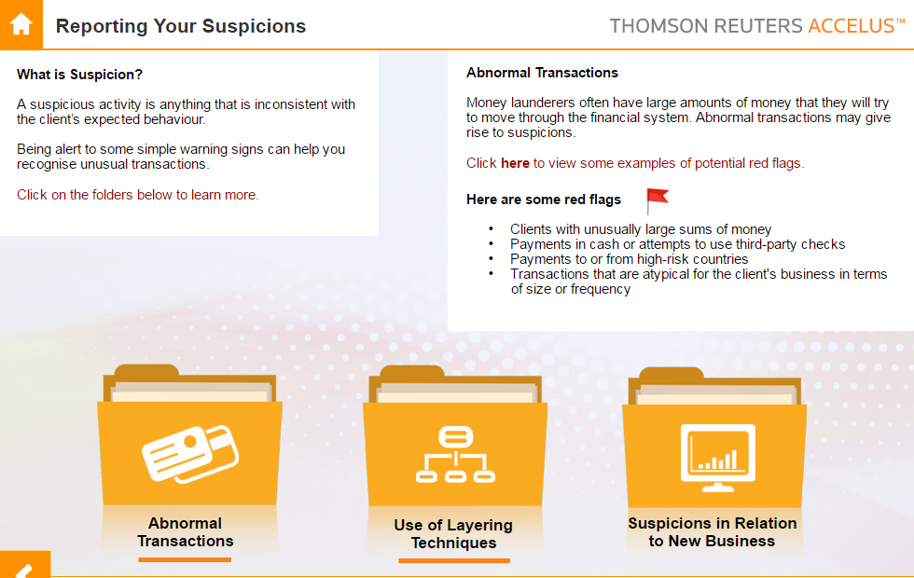
Anti Money Laundering

Slide 39
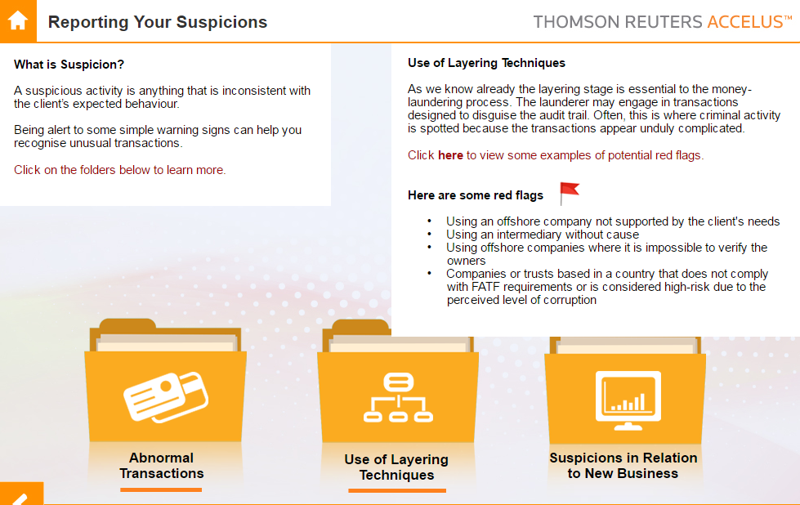
Anti Money Laundering

Slide 40
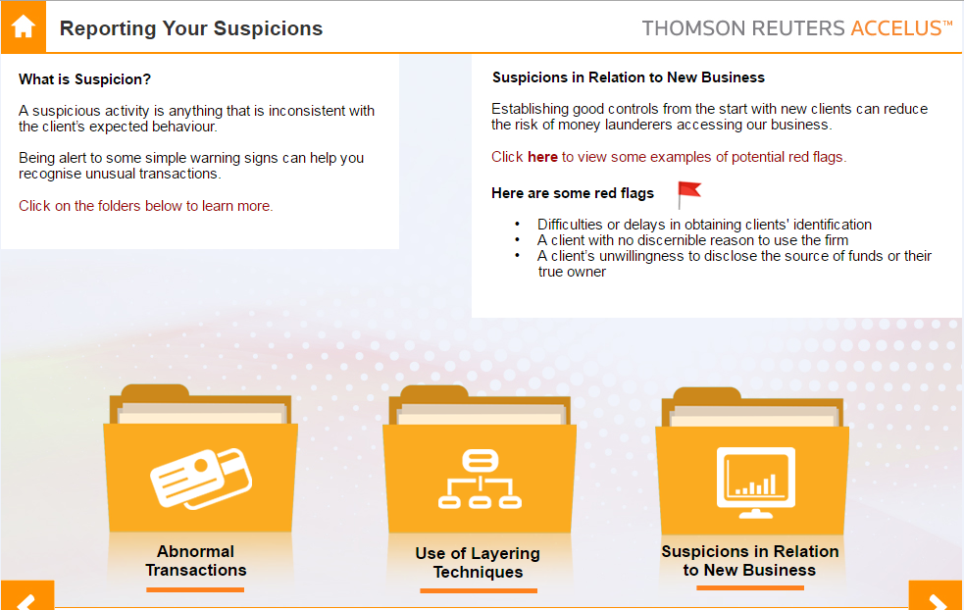
Anti Money Laundering

Slide 41
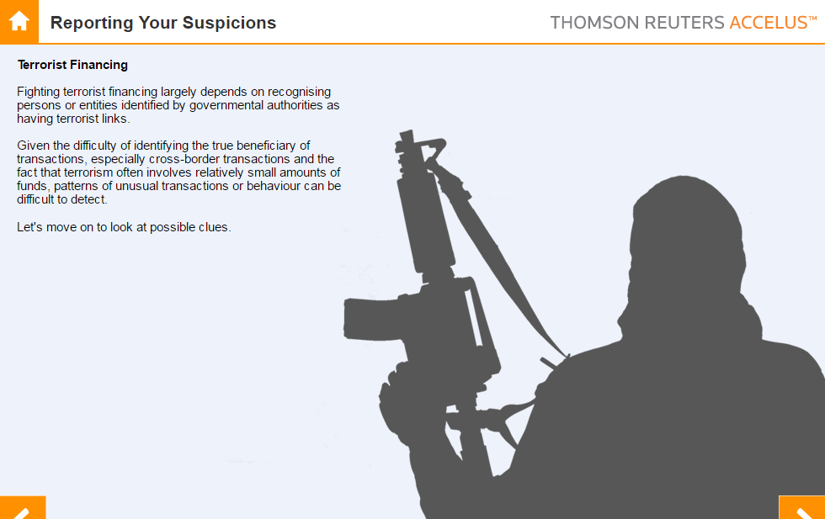
Anti Money Laundering

Slide 42
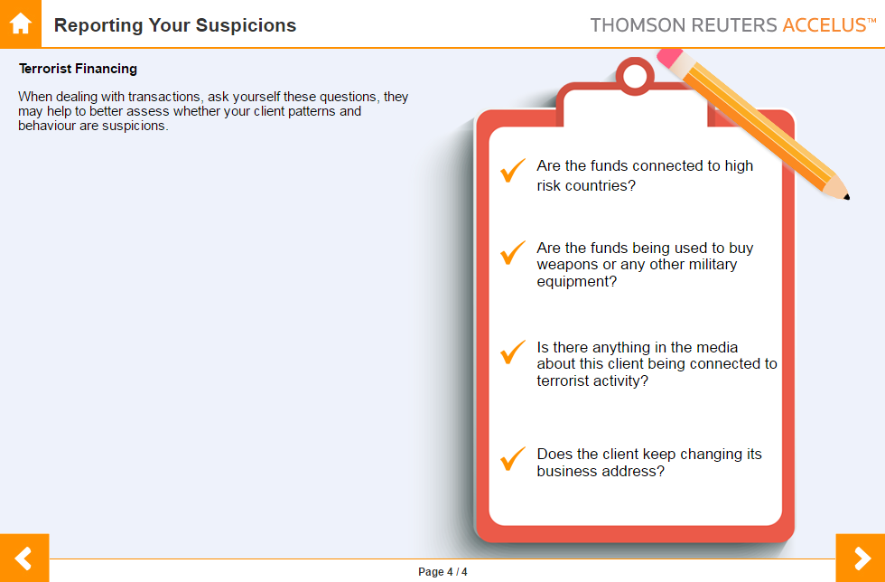
Anti Money Laundering

Slide 43
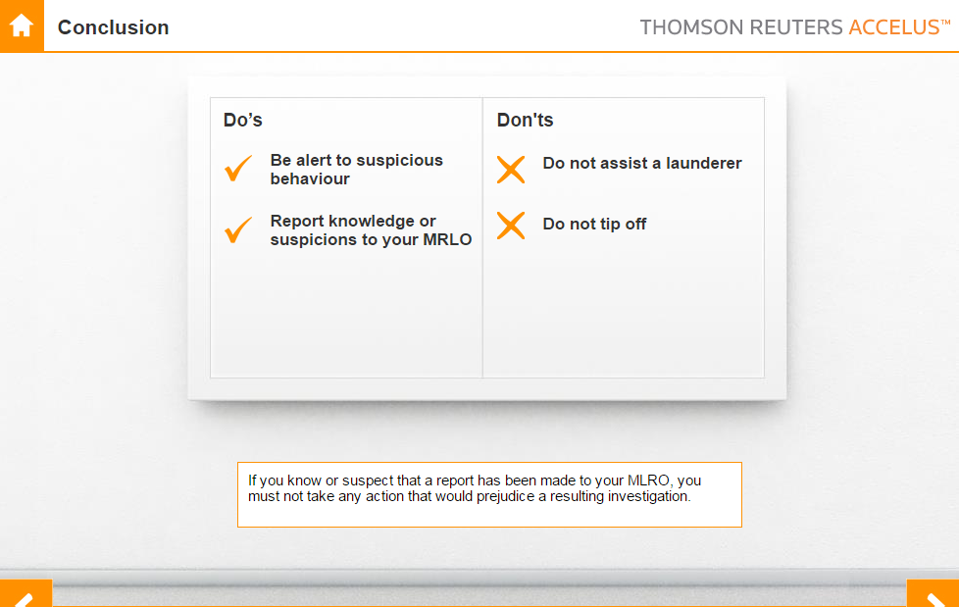
Anti Money Laundering

Slide 44

Q & A
Thanks!

